Slide 1
NT219- Cryptography
Week 3: Modern Symmetric Ciphers
PhD. Ngoc-Tu Nguyen
tunn@uit.edu.vn

Slide 2
What is cryptograph?
Cryptology= Cryptography + Cryptanalysis
Goals
What?
Cipher systems
- Sysmmetric (AES)
- Asymmetric (RSA, ECC, CRYSTALS-KYBER)
Confidentiality
Privacy
Integrity
Hash functions
Message authentication code (MAC)
Digital signature (digital certificate)
Authentication
Non-repudiation (Accountability)
Availability

Slide 3
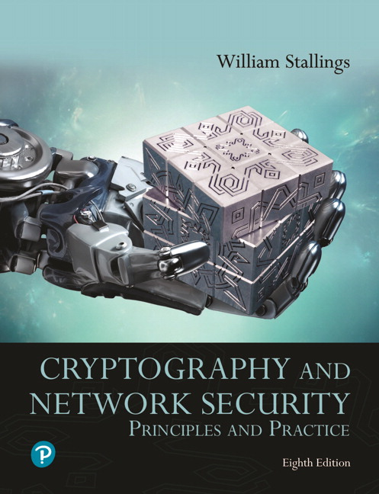
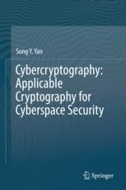
Textbooks and References
Text books
[1] Chapter 4,6
[2] Chapter 5

Slide 4
Classical cipher algorithms
Substitution Technique
Monoalphabetic cipher
Replace one character by another character
Replace one character by other characters
Polyalphabetic cipher
Replace some characters by other characters
2 by 2:
3 by 3 or n by n
Transposition Technique
Keep the same source characters bat change their positions
Notes:
The two basic building blocks of all encryption techniques are substitution
and transposition. We examine these in the next two sections. Finally, we discuss a
system that combines both substitution and transposition.
A substitution technique is one in which the letters of plaintext are replaced by
other letters or by numbers or symbols. If the plaintext is viewed as a sequence of bits,
then substitution involves replacing plaintext bit patterns with ciphertext bit patterns.

Slide 5

Polyalphabetic Cipher
Polyalphabetic Cipher: Replace some characters by other characters
Playfair Cipher: replace 2 characters by 2 characters
Hill Cipher: replace 3 characters by 3 characters, …
Vigenère Cipher

Slide 6
Playfair encryption
+1
M | O | N | A | R
C | H | Y | B | D
E | F | G | I/J | K
L | P | Q | S | T
U | V | W | X | Z
Key matrix
+1
Plaintext: "Hide the gold in the tree stump"
Plaintext diagram:
HI DE TH EG OL DI NT HE TR EX ES TU MP
Ciphertext diagram:
BF CK PD FI .. .. .. .. ZD
https://en.wikipedia.org/wiki/Playfair_cipher
Notes:
In this case, the keyword is monarchy . The matrix is constructed by filling
in the letters of the keyword (minus duplicates) from left to right and from top to
bottom, and then filling in the remainder of the matrix with the remaining letters in
alphabetic order. The letters I and J count as one letter. Plaintext is encrypted two
letters at a time, according to the following rules:
1. Repeating plaintext letters that are in the same pair are separated with a filler
letter, such as x, so that balloon would be treated as ba lx lo on.
2. Two plaintext letters that fall in the same row of the matrix are each replaced
by the letter to the right, with the first element of the row circularly following
the last. For example, ar is encrypted as RM.
3. Two plaintext letters that fall in the same column are each replaced by the
letter beneath, with the top element of the column circularly following the last.
For example, mu is encrypted as CM.
4. Otherwise, each plaintext letter in a pair is replaced by the letter that lies in
its own row and the column occupied by the other plaintext letter. Thus, hs
becomes BP and ea becomes IM (or JM, as the encipherer wishes).
The Playfair cipher is a great advance over simple monoalphabetic ciphers.
For one thing, whereas there are only 26 letters, there are 26 * 26 = 676 digrams, so
that identification of individual digrams is more difficult. Furthermore, the relative
frequencies of individual letters exhibit a much greater range than that of digrams,
making frequency analysis much more difficult. For these reasons, the Playfair
cipher was for a long time considered unbreakable. It was used as the standard field
system by the British Army in World War I and still enjoyed considerable use by the
U.S. Army and other Allied forces during World War II.
Despite this level of confidence in its security, the Playfair cipher is relatively
easy to break, because it still leaves much of the structure of the plaintext language
intact. A few hundred letters of ciphertext are generally sufficient.

Slide 7




Polyalphabetic Cipher
Cryptoanalys Playfair cipher
Digram
Two-letter combination
Most common is th
Trigram
Three-letter combination
Most frequent is the
Notes:
A powerful tool is to look at the frequency of two-letter combinations, known
as digrams . A table similar to Figure 3.5 could be drawn up showing the relative frequency
of digrams. The most common such digram is th. In our ciphertext, the most
common digram is ZW, which appears three times. So we make the correspondence
of Z with t and W with h. Then, by our earlier hypothesis, we can equate P with e.
Now notice that the sequence ZWP appears in the ciphertext, and we can translate
that sequence as “the.” This is the most frequent trigram (three-letter combination)
in English, which seems to indicate that we are on the right track.
Next, notice the sequence ZWSZ in the first line. We do not know that these
four letters form a complete word, but if they do, it is of the form th_t. If so, S
equates with a.
So far, then, we have
UZQSOVUOHXMOPVGPOZPEVSGZWSZOPFPESXUDBMETSXAIZ
t a e e te a that e e a a
VUEPHZHMDZSHZOWSFPAPPDTSVPQUZWYMXUZUHSX
e t ta t ha e ee a e th t a
EPYEPOPDZSZUFPOMBZWPFUPZHMDJUDTMOHMQ
e e e tat e the t
Only four letters have been identified, but already we have quite a bit of the
message. Continued analysis of frequencies plus trial and error should easily yield a
solution from this point. The complete plaintext, with spaces added between words,
follows:
it was disclosed yesterday that several informal but
direct contacts have been made with political
representatives of the Viet cong in Moscow
Monoalphabetic ciphers are easy to break because they reflect the frequency
data of the original alphabet. A countermeasure is to provide multiple substitutes,
known as homophones, for a single letter. For example, the letter e could be assigned
a number of different cipher symbols, such as 16, 74, 35, and 21, with each
homophone assigned to a letter in rotation or randomly. If the number of symbols
assigned to each letter is proportional to the relative frequency of that letter, then
single-letter frequency information is completely obliterated. The great mathematician
Carl Friedrich Gauss believed that he had devised an unbreakable cipher using
homophones. However, even with homophones, each element of plaintext affects
only one element of ciphertext, and multiple-letter patterns (e.g., digram frequencies)
still survive in the ciphertext, making cryptanalysis relatively straightforward.
Two principal methods are used in substitution ciphers to lessen the extent to
which the structure of the plaintext survives in the ciphertext: One approach is to
encrypt multiple letters of plaintext, and the other is to use multiple cipher alphabets.
We briefly examine each.

Slide 8
Cryptanalysis Playfair
+1
Guess the
Key?
M | O | N | A | R
C | H | Y | B | D
E | F | G | I/J | K
L | P | Q | S | T
U | V | W | X | Z
+1
UnigramScorer: Single letter frequences;
https://en.wikipedia.org/wiki/Frequency_analysis
DigramScorer: Bigram frequences
https://en.wikipedia.org/wiki/Bigram
QuadgramScorer: Trigram frequences
https://en.wikipedia.org/wiki/Trigram
Notes:
In this case, the keyword is monarchy . The matrix is constructed by filling
in the letters of the keyword (minus duplicates) from left to right and from top to
bottom, and then filling in the remainder of the matrix with the remaining letters in
alphabetic order. The letters I and J count as one letter. Plaintext is encrypted two
letters at a time, according to the following rules:
1. Repeating plaintext letters that are in the same pair are separated with a filler
letter, such as x, so that balloon would be treated as ba lx lo on.
2. Two plaintext letters that fall in the same row of the matrix are each replaced
by the letter to the right, with the first element of the row circularly following
the last. For example, ar is encrypted as RM.
3. Two plaintext letters that fall in the same column are each replaced by the
letter beneath, with the top element of the column circularly following the last.
For example, mu is encrypted as CM.
4. Otherwise, each plaintext letter in a pair is replaced by the letter that lies in
its own row and the column occupied by the other plaintext letter. Thus, hs
becomes BP and ea becomes IM (or JM, as the encipherer wishes).
The Playfair cipher is a great advance over simple monoalphabetic ciphers.
For one thing, whereas there are only 26 letters, there are 26 * 26 = 676 digrams, so
that identification of individual digrams is more difficult. Furthermore, the relative
frequencies of individual letters exhibit a much greater range than that of digrams,
making frequency analysis much more difficult. For these reasons, the Playfair
cipher was for a long time considered unbreakable. It was used as the standard field
system by the British Army in World War I and still enjoyed considerable use by the
U.S. Army and other Allied forces during World War II.
Despite this level of confidence in its security, the Playfair cipher is relatively
easy to break, because it still leaves much of the structure of the plaintext language
intact. A few hundred letters of ciphertext are generally sufficient.

Slide 9
(4) Hill Cipher
Polyalphabetic Cipher
Developed by the mathematician Lester Hill in 1929
Strength is that it completely hides single-letter frequencies
The use of a larger matrix hides more frequency information
A 3 x 3 Hill cipher hides not only single-letter but also two-letter frequency information
Strong against a ciphertext-only attack but easily broken with a known plaintext attack
Notes:
Another interesting multiletter cipher is the Hill cipher, developed by the mathematician
Lester Hill in 1929.
Before describing the Hill cipher, let us briefly
review some terminology from linear algebra. In this discussion, we are concerned
with matrix arithmetic modulo 26. For the reader who needs a refresher on matrix
multiplication and inversion, see Appendix A.
We define the inverse M⁻¹ of a square matrix M by the equation
M (M⁻¹ ) = M⁻¹M = I , where I is the identity matrix. I is a square matrix that is all
zeros except for ones along the main diagonal from upper left to lower right. The
inverse of a matrix does not always exist, but when it does, it satisfies the preceding
equation.
To explain how the inverse of a matrix is computed, we begin with the concept
of determinant. For any square matrix (m * m ), the determinant equals the sum of
all the products that can be formed by taking exactly one element from each row
and exactly one element from each column, with certain of the product terms preceded
by a minus sign.
This encryption algorithm takes m successive plaintext letters
and substitutes for them m ciphertext letters. The substitution is determined
by m linear equations in which each character is assigned a numerical value
(a = 0, b = 1, …. , z = 25).
As with Playfair, the strength of the Hill cipher is that it completely hides
single-letter frequencies. Indeed, with Hill, the use of a larger matrix hides more
frequency information. Thus, a 3 * 3 Hill cipher hides not only single-letter but
also two-letter frequency information.
Although the Hill cipher is strong against a ciphertext-only attack, it is
easily broken with a known plaintext attack.

Slide 10
(5) Vigenère Cipher
Polyalphabetic Cipher
Best known and one of the simplest polyalphabetic substitution ciphers
In this scheme the set of related monoalphabetic substitution rules consists of the 26 Caesar ciphers with shifts of 0 through 25
Each cipher is denoted by a key letter which is the ciphertext letter that substitutes for the plaintext letter a
https://en.wikipedia.org/wiki/Vigen%C3%A8re_cipher
Notes:
The best known, and one of the simplest, polyalphabetic ciphers
is the Vigenère cipher. In this scheme, the set of related monoalphabetic substitution
rules consists of the 26 Caesar ciphers with shifts of 0 through 25. Each cipher is
denoted by a key letter, which is the ciphertext letter that substitutes for the plaintext
letter a. Thus, a Caesar cipher with a shift of 3 is denoted by the key value 3.

Slide 11
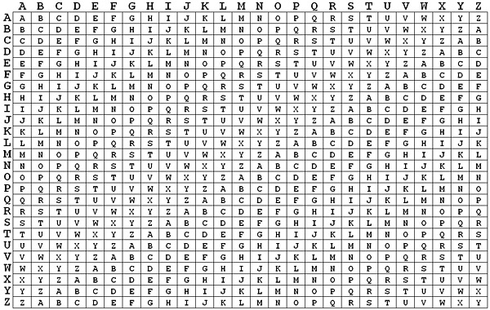
Vigenère Cipher
Vigenère matrix
Key: deceptiv
3
1
2,
4
7
5
6
8

Slide 12
Example of Vigenère Cipher
To encrypt a message, a key is needed that is as long as the message
Usually, the key is a repeating keyword
For example, if the keyword is deceptive, the message “we are discovered save yourself” is encrypted as:
key: deceptivedeceptivedeceptive
plaintext: wearediscoveredsaveyourself
ciphertext: ??
Notes:
To encrypt a message, a key is needed that is as long as the message. Usually,
the key is a repeating keyword. For example, if the keyword is deceptive, the
message “we are discovered save yourself” is encrypted as
key: deceptivedeceptivedeceptive
plaintext: wearediscoveredsaveyourself
ciphertext: ZICVTWQNGRZGVTWAVZHCQYGLMGJ
The strength of this cipher is that there are multiple ciphertext letters for
each plaintext letter, one for each unique letter of the keyword. Thus, the letter
frequency information is obscured. However, not all knowledge of the plaintext
structure is lost. For example, Figure 3.6 shows the frequency distribution for a
Vigenère cipher with a keyword of length 9. An improvement is achieved over the
Playfair cipher, but considerable frequency information remains.

Slide 13
Vigenère Autokey System
Example:
plaintext: w e a r e d i s coveredsaveyourself
key: d e c e p t I v ewearediscoveredsav
ciphertext: ZICVTWQNGKZEIIGASXSTSLVVWLA
Even this scheme is vulnerable to cryptanalysis
Because the key and the plaintext share the same frequency distribution of letters, a statistical technique can be applied
Notes:
The periodic nature of the keyword can be eliminated by using a nonrepeating
keyword that is as long as the message itself. Vigenère proposed what is referred to
as an autokey system , in which a keyword is concatenated with the plaintext itself to
provide a running key. For our example,
key: deceptivewearediscoveredsav
plaintext: wearediscoveredsaveyourself
ciphertext: ZICVTWQNGKZEIIGASXSTSLVVWLA
Even this scheme is vulnerable to cryptanalysis. Because the key and the
plaintext share the same frequency distribution of letters, a statistical technique
can be applied. For example, e enciphered by e , by Figure 3.5, can be expected to
occur with a frequency of (0.127⁾² = 0.016, whereas t enciphered by t would occur
only about half as often. These regularities can be exploited to achieve successful
cryptanalysis.

Slide 14
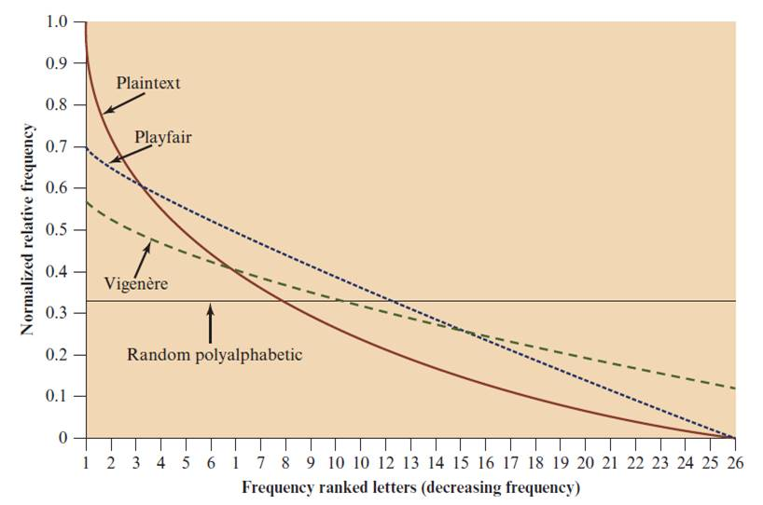
Classical symmetric cipher cryptanalysis
Notes:
One way of revealing the effectiveness of the Playfair and other ciphers
is shown in Figure 3.6. The line labeled plaintext plots a typical frequency
distribution of the 26 alphabetic characters (no distinction between upper
and lower case) in ordinary text. This is also the frequency distribution of any
monoalphabetic substitution cipher, because the frequency values for individual
letters are the same, just with different letters substituted for the original letters.
The plot is developed in the following way: The number of occurrences of each
letter in the text is counted and divided by the number of occurrences of the
most frequently used letter. Using the results of Figure 3.5, we see that
e is the most frequently used letter. As a result, e has a relative frequency of 1, t of
9.056/12.702 0.72, and so on. The points on the horizontal axis correspond
to the letters in order of decreasing frequency.
Figure 3.6 also shows the frequency distribution that results when the text
is encrypted using the Playfair cipher. To normalize the plot, the number of
occurrences of each letter in the ciphertext was again divided by the number of
occurrences of e in the plaintext. The resulting plot therefore shows the extent
to which the frequency distribution of letters, which makes it trivial to solve
substitution ciphers, is masked by encryption. If the frequency distribution
information were totally concealed in the encryption process, the ciphertext plot
of frequencies would be flat, and cryptanalysis using ciphertext only would be
effectively impossible. As the figure shows, the Playfair cipher has a flatter distribution
than does plaintext, but nevertheless, it reveals plenty of structure for
a cryptanalyst to work with. The plot also shows the Vigenère cipher, discussed
subsequently. The Hill and Vigenère curves on the plot are based on results
reported in [SIMM93].

Slide 15
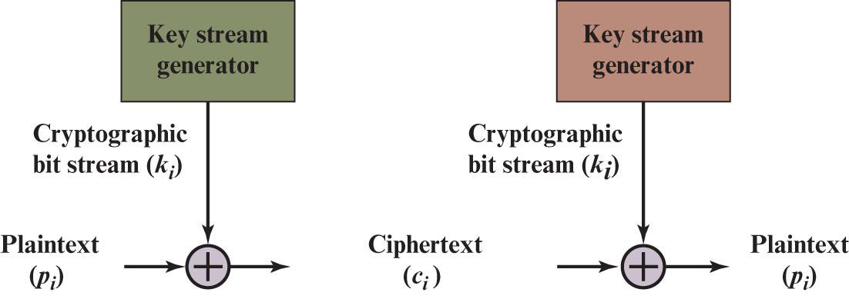
(6) Vernam Cipher
Stream ciper
https://en.wikipedia.org/wiki/Gilbert_Vernam
Notes:
The ultimate defense against such a cryptanalysis is to choose a
keyword that is as long as the plaintext and has no statistical relationship to it. Such
a system was introduced by an AT&T engineer named Gilbert Vernam in 1918.
His system works on binary data (bits) rather than letters.
The essence of this technique is the means of construction of the key. Vernam
proposed the use of a running loop of tape that eventually repeated the key, so
that in fact the system worked with a very long but repeating keyword. Although
such a scheme, with a long key, presents formidable cryptanalytic difficulties, it
can be broken with sufficient ciphertext, the use of known or probable plaintext
sequences, or both.

Slide 16

One-Time Pad
Improvement to Vernam cipher proposed by an Army Signal Corp officer, Joseph Mauborgne
Use a random key that is as long as the message so that the key need not be repeated
Key is used to encrypt and decrypt a single message and then is discarded
Each new message requires a new key of the same length as the new message
Scheme is unbreakable
Produces random output that bears no statistical relationship to the plaintext
Because the ciphertext contains no information whatsoever about the plaintext, there is simply no way to break the code
Notes:
An Army Signal Corp officer, Joseph Mauborgne, proposed an improvement to the
Vernam cipher that yields the ultimate in security. Mauborgne suggested using a
random key that is as long as the message, so that the key need not be repeated. In
addition, the key is to be used to encrypt and decrypt a single message, and then is
discarded. Each new message requires a new key of the same length as the new message.
Such a scheme, known as a one-time pad , is unbreakable. It produces random
output that bears no statistical relationship to the plaintext. Because the ciphertext
contains no information whatsoever about the plaintext, there is simply no way to
break the code.
In fact, given any plaintext of equal length to the ciphertext, there is a key that
produces that plaintext. Therefore, if you did an exhaustive search of all possible
keys, you would end up with many legible plaintexts, with no way of knowing which
was the intended plaintext. Therefore, the code is unbreakable.
The security of the one-time pad is entirely due to the randomness of
the key. If the stream of characters that constitute the key is truly random, then the
stream of characters that constitute the ciphertext will be truly random. Thus, there
are no patterns or regularities that a cryptanalyst can use to attack the ciphertext.

Slide 17
Difficulties
The one-time pad offers complete security but, in practice, has two fundamental difficulties:
There is the practical problem of making large quantities of random keys
Any heavily used system might require millions of random characters on a regular basis
Mammoth key distribution problem
For every message to be sent, a key of equal length is needed by both sender and receiver
Because of these difficulties, the one-time pad is of limited utility
Useful primarily for low-bandwidth channels requiring very high security
The one-time pad is the only cryptosystem that exhibits perfect secrecy (see Appendix F)
Notes:
In theory, we need look no further for a cipher. The one-time pad offers complete
security but, in practice, has two fundamental difficulties:
1. There is the practical problem of making large quantities of random keys.
Any heavily used system might require millions of random characters
on a regular basis. Supplying truly random characters in this volume is a
significant task.
2. Even more daunting is the problem of key distribution and protection. For
every message to be sent, a key of equal length is needed by both sender and
receiver. Thus, a mammoth key distribution problem exists.
Because of these difficulties, the one-time pad is of limited utility and is useful
primarily for low-bandwidth channels requiring very high security.
The one-time pad is the only cryptosystem that exhibits what is referred to as
perfect secrecy . This concept is explored in Appendix B.

Slide 18
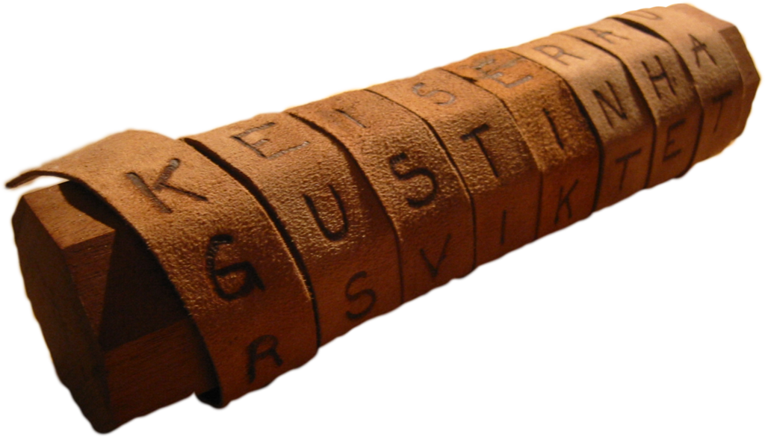
Transposition ciphers (permutation cipher)
Goals: scrambles the positions of characters
(1) Rail fence cipher
(2) Columnar Transposition Cipher
(3)
https://en.wikipedia.org/wiki/Transposition_cipher
Notes:
All the techniques examined so far involve the substitution of a ciphertext symbol
for a plaintext symbol. A very different kind of mapping is achieved by performing
some sort of permutation on the plaintext letters. This technique is referred to as a
transposition cipher.
The simplest such cipher is the rail fence technique, in which the plaintext is
written down as a sequence of diagonals and then read off as a sequence of rows.
For example, to encipher the message “meet me after the toga party” with a rail
fence of depth 2, we write the following:
m e m a t r h t g p r y
e t e f e t e o a a t
The encrypted message is
MEMATRHTGPRYETEFETEOAAT

Slide 19
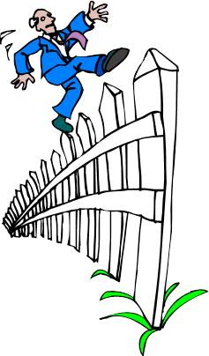
Transposition cipher
(1) Rail fence cipher
Simplest transposition cipher
Plaintext is written down as a sequence of diagonals and then read off as a sequence of rows
To encipher the message “meet me after the toga party” with a rail fence of depth 2, we would write:
Ciphertext
Encrypted message is:
MEMATRHTGPRYETEFETEOAAT
https://en.wikipedia.org/wiki/Rail_fence_cipher
Notes:
All the techniques examined so far involve the substitution of a ciphertext symbol
for a plaintext symbol. A very different kind of mapping is achieved by performing
some sort of permutation on the plaintext letters. This technique is referred to as a
transposition cipher.
The simplest such cipher is the rail fence technique, in which the plaintext is
written down as a sequence of diagonals and then read off as a sequence of rows.
For example, to encipher the message “meet me after the toga party” with a rail
fence of depth 2, we write the following:
m e m a t r h t g p r y
e t e f e t e o a a t
The encrypted message is
MEMATRHTGPRYETEFETEOAAT

Slide 20
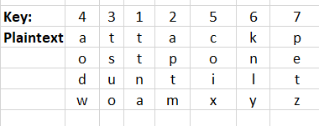
Columnar Transposition Cipher
Is a more complex transposition
Write the message in a rectangle, row by row, and read the message off, column by column, but permute the order of the columns
The order of the columns then becomes the key to the algorithm
Ciphertext
Ciphertext: TTNAAPTMTSUOAODWCOIXKNLYPETZ
Notes:
A more complex scheme is
to write the message in a rectangle, row by row, and read the message off, column
by column, but permute the order of the columns. The order of the columns then
becomes the key to the algorithm. For example,
Key: 4 3 1 2 5 6 7
Plaintext: a t t a c k p
o s t p o n e
d u n t i l t
w o a m x y z
Ciphertext: TTNAAPTMTSUOAODWCOIXKNLYPETZ
Thus, in this example, the key is 4312567. To encrypt, start with the column
that is labeled 1, in this case column 3. Write down all the letters in that column.
Proceed to column 4, which is labeled 2, then column 2, then column 1, then
columns 5, 6, and 7.
A pure transposition cipher is easily recognized because it has the same letter
frequencies as the original plaintext. For the type of columnar transposition just
shown, cryptanalysis is fairly straightforward and involves laying out the ciphertext
in a matrix and playing around with column positions. Digram and trigram
frequency tables can be useful.
The transposition cipher can be made significantly more secure by performing
more than one stage of transposition. The result is a more complex permutation
that is not easily reconstructed.

Slide 21
Classical symmetric cipher cryptanalysis
Notes:
One way of revealing the effectiveness of the Playfair and other ciphers
is shown in Figure 3.6. The line labeled plaintext plots a typical frequency
distribution of the 26 alphabetic characters (no distinction between upper
and lower case) in ordinary text. This is also the frequency distribution of any
monoalphabetic substitution cipher, because the frequency values for individual
letters are the same, just with different letters substituted for the original letters.
The plot is developed in the following way: The number of occurrences of each
letter in the text is counted and divided by the number of occurrences of the
most frequently used letter. Using the results of Figure 3.5, we see that
e is the most frequently used letter. As a result, e has a relative frequency of 1, t of
9.056/12.702 0.72, and so on. The points on the horizontal axis correspond
to the letters in order of decreasing frequency.
Figure 3.6 also shows the frequency distribution that results when the text
is encrypted using the Playfair cipher. To normalize the plot, the number of
occurrences of each letter in the ciphertext was again divided by the number of
occurrences of e in the plaintext. The resulting plot therefore shows the extent
to which the frequency distribution of letters, which makes it trivial to solve
substitution ciphers, is masked by encryption. If the frequency distribution
information were totally concealed in the encryption process, the ciphertext plot
of frequencies would be flat, and cryptanalysis using ciphertext only would be
effectively impossible. As the figure shows, the Playfair cipher has a flatter distribution
than does plaintext, but nevertheless, it reveals plenty of structure for
a cryptanalyst to work with. The plot also shows the Vigenère cipher, discussed
subsequently. The Hill and Vigenère curves on the plot are based on results
reported in [SIMM93].

Slide 22




Stream Cipher (1 of 8)
Vigenère cipher
Plaintext stream
Secret key (Keystream)
Ciphertext
where
Notes:
A stream cipher is one that encrypts a digital data stream one bit or one byte at
a time. Examples of classical stream ciphers are the autokeyed Vigenère cipher
and the Vernam cipher. In the ideal case, a one-time pad version of the Vernam
cipher would be used (Figure 3.7), in which the keystream (k_{i} ) is as long as the
plaintext bit stream (p_{i} ). If the cryptographic keystream is random, then this cipher
is unbreakable by any means other than acquiring the keystream. However, the
keystream must be provided to both users in advance via some independent and
secure channel. This introduces insurmountable logistical problems if the intended
data traffic is very large.
Accordingly, for practical reasons, the bit-stream generator must be
implemented as an algorithmic procedure, so that the cryptographic bit stream
can be produced by both users. In this approach (Figure 4.1a), the bit-stream
generator is a key-controlled algorithm and must produce a bit stream that is
cryptographically strong. That is, it must be computationally impractical to
predict future portions of the bit stream based on previous portions of the bit
stream. The two users need only share the generating key, and each can produce
the keystream.

Slide 23




Stream Cipher (2 of 8)
Secret key (Keystream)
Plaintext stream
$$k1$$ | $$k2$$ | $$k3$$ | $$…$$ | $$k_{n}$$
$$m1$$ | $$m2$$ | $$m3$$ | $$…$$ | $$m_{n}$$
bit or byte
Ciphertext
$$k1⨁m1$$ | $$k2⨁m2$$ | $$…$$ | $${k_{n}⨁m}_{n}$$
where
Notes:
A stream cipher is one that encrypts a digital data stream one bit or one byte at
a time. Examples of classical stream ciphers are the autokeyed Vigenère cipher
and the Vernam cipher. In the ideal case, a one-time pad version of the Vernam
cipher would be used (Figure 3.7), in which the keystream (k_{i} ) is as long as the
plaintext bit stream (p_{i} ). If the cryptographic keystream is random, then this cipher
is unbreakable by any means other than acquiring the keystream. However, the
keystream must be provided to both users in advance via some independent and
secure channel. This introduces insurmountable logistical problems if the intended
data traffic is very large.
Accordingly, for practical reasons, the bit-stream generator must be
implemented as an algorithmic procedure, so that the cryptographic bit stream
can be produced by both users. In this approach (Figure 4.1a), the bit-stream
generator is a key-controlled algorithm and must produce a bit stream that is
cryptographically strong. That is, it must be computationally impractical to
predict future portions of the bit stream based on previous portions of the bit
stream. The two users need only share the generating key, and each can produce
the keystream.

Slide 24
Stream Cipher (3 of 8)
Encrypts a digital data stream one bit or one byte at a time
Examples:
Autokeyed Vigenère cipher
Vernam cipher
In the ideal case, a one-time pad version of the Vernam cipher would be used, in which the keystream is as long as the plaintext bit stream
If the cryptographic keystream is random, then this cipher is unbreakable by any means other than acquiring the keystream
Keystream must be provided to both users in advance via some independent and secure channel
This introduces insurmountable logistical problems if the intended data traffic is very large
Notes:
A stream cipher is one that encrypts a digital data stream one bit or one byte at
a time. Examples of classical stream ciphers are the autokeyed Vigenère cipher
and the Vernam cipher. In the ideal case, a one-time pad version of the Vernam
cipher would be used (Figure 3.7), in which the keystream (k_{i} ) is as long as the
plaintext bit stream (p_{i} ). If the cryptographic keystream is random, then this cipher
is unbreakable by any means other than acquiring the keystream. However, the
keystream must be provided to both users in advance via some independent and
secure channel. This introduces insurmountable logistical problems if the intended
data traffic is very large.
Accordingly, for practical reasons, the bit-stream generator must be
implemented as an algorithmic procedure, so that the cryptographic bit stream
can be produced by both users. In this approach (Figure 4.1a), the bit-stream
generator is a key-controlled algorithm and must produce a bit stream that is
cryptographically strong. That is, it must be computationally impractical to
predict future portions of the bit stream based on previous portions of the bit
stream. The two users need only share the generating key, and each can produce
the keystream.

Slide 25
Stream Cipher (4 of 8)
For practical: must be implemented as an algorithmic to generate key bit stream (both users)
It must be computationally impractical to predict future portions of the bit stream based on previous portions of the bit stream
The two users need only share the generating key and each can produce the keystream

Slide 26
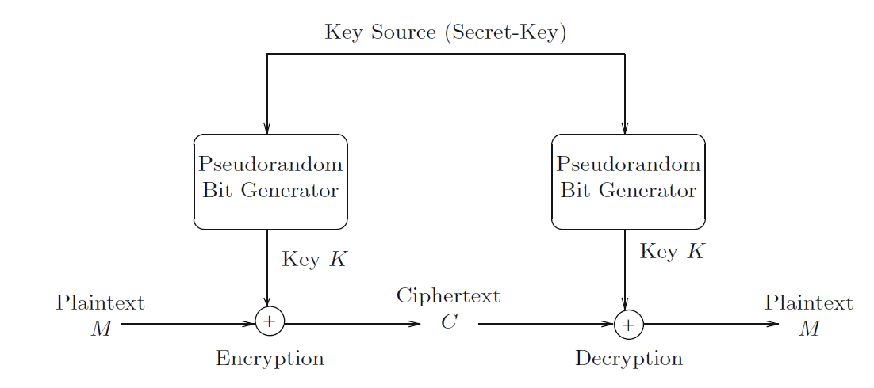
Stream Cipher (5 of 8)
“Secret Seed”

Slide 27
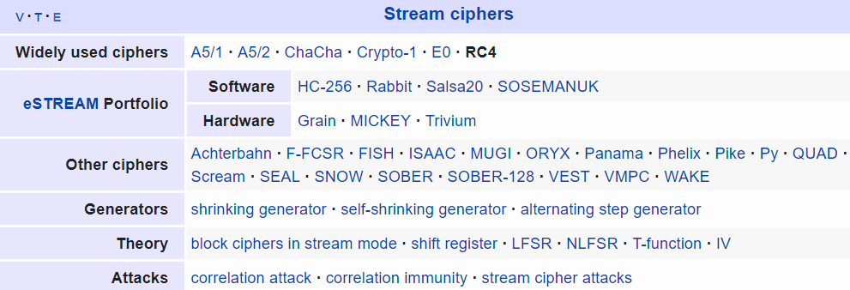
Stream Cipher (6 of 8)
Rivest Cipher 4
https://en.wikipedia.org/wiki/RC4
Chaotic-based cryptosystem
https://en.wikipedia.org/wiki/List_of_chaotic_maps

Slide 28
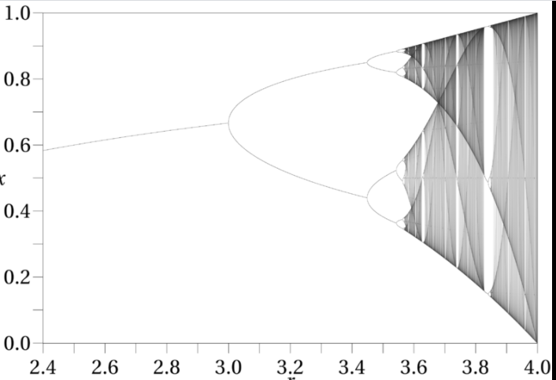


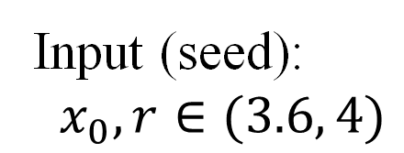
Stream Cipher (7 of 8)
Chaotic-based cryptosystem
Example:
Logistic map
Input (seed):
$x_{0}, r∈(3.6, 4)$
Output:
$${ x}_{1},x_{2},x_{3},…x_{n},….$$
$$0<x_{i}<1$$

Slide 29

Stream Cipher (8 of 8)
Chaotic-based crypto system
Chaotic maps
Image$,$ Video
One-time key!
Session key?
(in network!)

Slide 30
Outline (week 4,5)
Stream Cipher
Block cipher
Data Encryption Standard (DES)
Advanced Encryption Standard (AES)
Some other ciphers
Searchable encryption
Notes:
Cipher=a secret system of writing;

